Slide 1
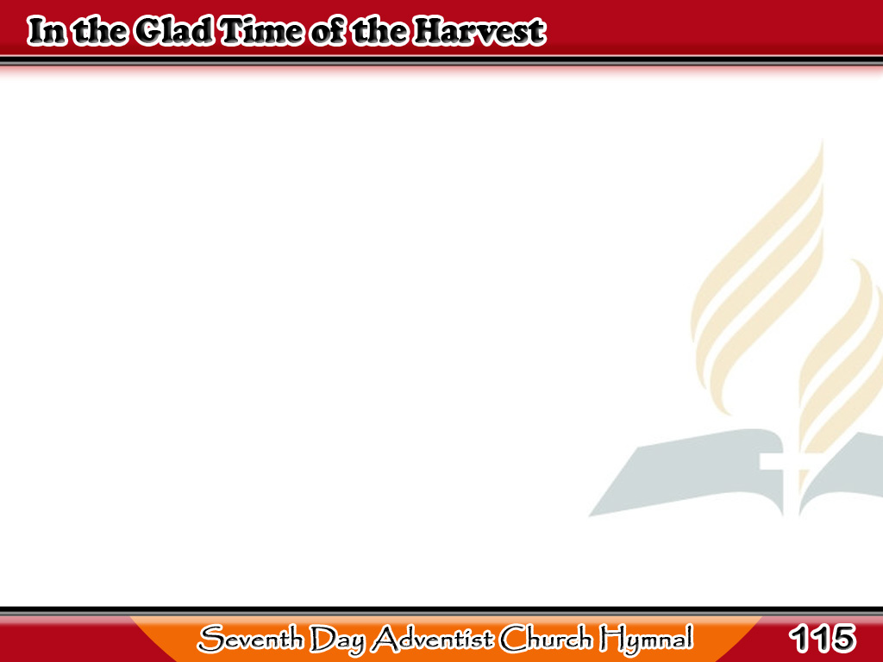
Pagdating ng Pag-aani
In the glad time of the harvest,
In the grand millennial year,
When the King
shall take His scepter,
And to judge the world appear,
1/4

Slide 2
Pagdating ng Pag-aani
Earth and sea
shall yield their treasure,
All shall stand
before the throne;
1/4

Slide 3
Pagdating ng Pag-aani
Just awards will
then be given,
When the King
shall claim His own.
1/4

Slide 4
Pagdating ng Pag-aani
O the rapture of His people!
Long they’ve dwelt
on earth’s low sod,
2/4

Slide 5
Pagdating ng Pag-aani
With their hearts
e’er turning homeward,
Rich in faith and love to God.
2/4

Slide 6
Pagdating ng Pag-aani
They will share the life immortal,
They will know as they are know,
They will pass the pearly portal,
When the King
shall claim His own.
2/4

Slide 7
Pagdating ng Pag-aani
Pagdating ng Pag-aani
Long they’ve toiled
within the harvest,
Sown the precious seed
with tears;
3/4

Slide 8
Pagdating ng Pag-aani
Soon they’ll drop
their heavy burdens
In the glad millennial years;
3/4

Slide 9
Pagdating ng Pag-aani
They will share
the bliss of heaven,
Nevermore to sigh or moan;
3/4

Slide 10
Starry crowns
will then be given,
When the King
shall claim His own.
3/4

Slide 11
Pagdating ng Pag-aani
We shall greet
the loved and loving,
Who have left us lonely here;
Every heartache will be banished
When the Saviour shall appear;
4/4

Slide 12
Pagdating ng Pag-aani
Never grieved with sin or sorrow,
Never weary or alone;
O, we long for that glad morrow
When the King
shall claim His own.
4/4

